Slide 1
7
Information Security

Slide 2
Introduction to Information Security
Unintentional Threats to Information Systems
Deliberate Threats to Information Systems
What Organizations Are Doing to Protect Information Resources
Information Security Controls

Slide 3
Identify the five factors that contribute to the increasing vulnerability of information resources, and provide a specific example of each one.
Compare and contrast human mistakes and social engineering, and provide a specific example of each one.
Discuss the 10 types of deliberate attacks.

Slide 4
Define the three risk mitigation strategies, and provide an example of each one in the context of owning a home.
Identify the three major types of controls that organizations can use to protect their information resources, and provide an example of each one.

Slide 5
Shodan: Good Tool or Bad Tool?
Is Shodan more useful for hackers or for security defenders? Provide specific examples to support your choice.
What impact should Shodan have on the manufacturers of devices that connect to the Internet?
As an increasingly large number of devices are connected to the Internet, what will Shodan’s impact be? Provide examples to support your answer.

Slide 6
7.1
Introduction to Information Security
Information Security
Threat
Exposure
Vulnerability
Five Key Factors Increasing Vulnerability
Cybercrime
Notes:
Security: the degree of protection against criminal activity, danger, damage, and/or loss.
Information Security: all of the processes and policies designed to protect an organization’s information and information systems (IS) from unauthorized access, use, disclosure, disruption, modification, or destruction.
Threat: any danger to which a system may be exposed.
Exposure: of an information resource is the harm, loss, or damage that can result if a threat compromises that resource.
Vulnerability: the possibility that the system will be harmed by a threat.
Cybercrime: refers to illegal activities conducted over computer networks, particularly the Internet. iDefense (http://labs.idefense.com), a company that specializes in providing security information to governments and Fortune 500 companies, maintains that groups of well-organized criminal organizations have taken control of a global billiondollar crime network.

Slide 7
Security can be defined as the degree of protection against criminal activity, danger, damage,and/or loss
information security refers to all of the processes and policies designed to protect an organization’s (IS) from unauthorized access, use, disclosure, disruption, modification, or destruction
A threat to an information resource is any danger to which a system may be exposed.
The exposure of an information resource is the harm, loss, or damage that can result if a threat compromises that resource.
An information resource’s vulnerability is the possibility that the system will be harmed by a threat.

Slide 8
Five Key Factors Increasing Vulnerability
Today’s interconnected, interdependent, wirelessly networked business environment
Smaller, faster, cheaper computers and storage devices
Decreasing skills necessary to be a computer hacker
International organized crime taking over cybercrime
Lack of management support

Slide 9
Unintentional Threats to Information Systems
Unintentional threats are acts performed without malicious intent that nevertheless represent a serious threat to information security.
A major category of unintentional threats is human error.

Slide 10
7.2
Unintentional Threats to Information Systems
Human Errors
Social Engineering
Notes:
Unintentional Threats: acts performed without malicious intent that nevertheless represent a serious threat to information security.

Slide 11
Human Errors
Higher employee levels = higher levels of security risk
higher-level employees typically have greater access to corporate data, and they enjoy greater privileges on organizational information systems.
Second, employees in two areas of the organization pose especially significant threats to information security: human resources and information systems.
Human resources employees generally have access to sensitive personal information about all employees.
IS employees not only have access to sensitive organizational data, but they often control the means to create, store, transmit, and modify that data
Other employees include contract labor, consultants, and janitors and guards
Human errors or mistakes by employees pose a large problem as the result of laziness,carelessness, or a lack of awareness concerning information security.

Slide 12
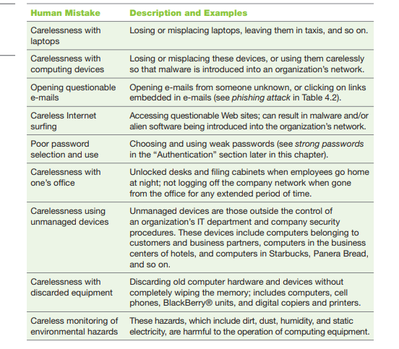

Slide 13
Dangerous Employees
Two organizational areas pose the greatest risk
Human Resources
Information Systems
Janitors and Guards Frequently Overlooked

Slide 14
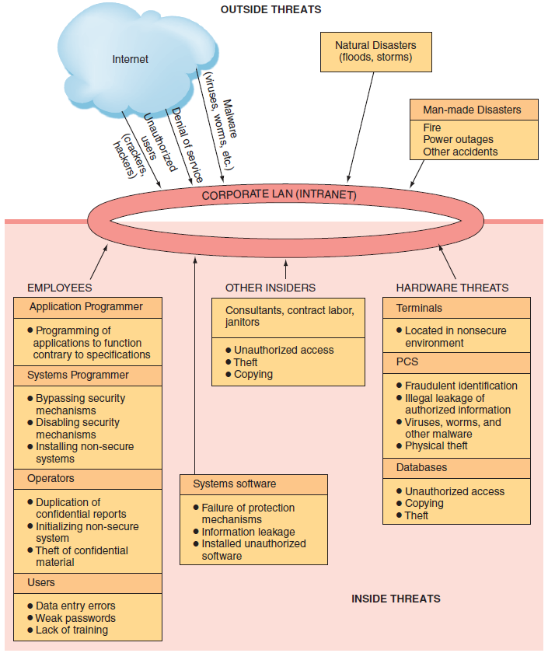
Figure 7.1 Security Threats:

Slide 15
Human Mistakes
Carelessness with laptops
Carelessness with computing devices
Opening questionable e-mails
Careless Internet surfing
Poor password selection and use
Carelessness with one’s office

Slide 16
Human Mistakes (continued)
Carelessness using unmanaged devices
Carelessness with discarded equipment
Careless monitoring of environmental hazards

Slide 17
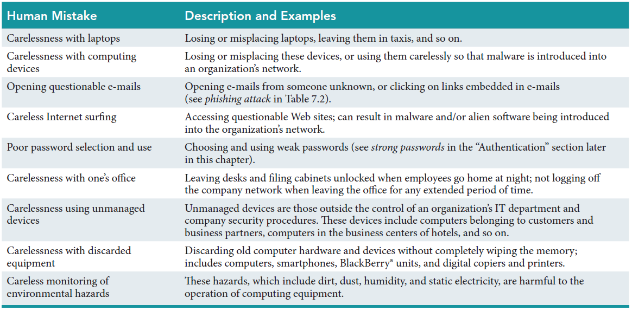
Table 7.1: Human Mistakes

Slide 18
Social Engineering
Social Engineering:
an attack in which the perpetrator uses social skills to trick or manipulate legitimate employees into providing confidential company information such as passwords.
The most common example of social engineering occurs when the attacker impersonates someone else on the telephone, such as a company manager or an information systems employee.
Two other social engineering techniques are tailgating and shoulder surfing.
Notes:
Social Engineering: an attack in which the perpetrator uses social skills to trick or manipulate legitimate employees into providing confidential company information such as passwords. The most common example of social engineering occurs when the attacker impersonates someone else on the telephone, such as a company manager or an information systems employee.

Slide 19
7.3
Deliberate Threats to Information Systems
Espionage or Trespass
Information Extortion
Sabotage or Vandalism
Theft of Equipment or Information
Identity Theft
Compromises to Intellectual Property
Notes:
Espionage or Trespass: occurs when an unauthorized individual attempts to gain illegal access to organizational information.
Information Extortion: occurs when an attacker either threatens to steal, or actually steals, information from a company. The perpetrator demands payment for not stealing the information, for returning stolen information, or for agreeing not to disclose the information.
Sabotage and Vandalism: deliberate acts that involve defacing an organization’s Web site, potentially damaging the organization’s image and causing its customers to lose faith.
Theft of Equipment or Information: Computing devices and storage devices are becoming smaller yet more powerful with vastly increased storage and as a result these devices are becoming easier to steal and easier for attackers to use to steal information.
Dumpster Diving: rummaging through commercial or residential trash to fi nd discarded information.
Identity Theft: is the deliberate assumption of another person’s identity, usually to gain access to his or her fi nancial information or to frame him or her for a crime.
Compromises to Intellectual Property:
Trade Secret: an intellectual work, such as a business plan, that is a company secret and is not based on public information.
Patent: an official document that grants the holder exclusive rights on an invention or a process for a specifi ed period of time.
Copyright: a statutory grant that provides the creators or owners of intellectual property with ownership of the property, also for a designated period.
Intellectual Property: the property created by individuals or corporations that is protected under trade secret, patent, and copyright laws.

Slide 20
7.3
Deliberate Threats to Information Systems (continued)
Software Attacks
Alien Software
Supervisory Control and Data Acquisition Attacks
Cyberterrorism and Cyberwarfare
Notes:
7. Software Attacks
8. Alien Software: clandestine soft ware that is installed on your computer through duplicitous methods.
9. SCADA: refers to a large-scale, distributed measurement and control system. SCADA systems are used to monitor or to control chemical, physical, and transport processes such as those used in oil refineries, water and sewage treatment plants, electrical generators, and nuclear power plants.
10. Cyberterrorism and Cyberwarfare: refer to malicious acts in which attackers use a target’s computer systems, particularly via the Internet, to cause physical, real-world harm or severe disruption, often to carry out a political agenda.

Slide 21
Compromises to Intellectual Property
Intellectual Property
Trade Secret
Patent
Copyright
Notes:
Compromises to Intellectual Property:
Trade Secret: an intellectual work, such as a business plan, that is a company secret and is not based on public information.
Patent: an official document that grants the holder exclusive rights on an invention or a process for a specifi ed period of time.
Copyright: a statutory grant that provides the creators or owners of intellectual property with ownership of the property, also for a designated period.
Intellectual Property: the property created by individuals or corporations that is protected under trade secret, patent, and copyright laws.

Slide 22
Deliberate Threats to Information Systems
Espionage or Trespass: occurs when an unauthorized individual attempts to gain illegal access to organizational information.
Information Extortion: when an attacker either threatens to steal, or actually steals, information from a company. The perpetrator demands payment for not stealing the information,for returning stolen information, or for agreeing not to disclose the information.

Slide 23
Deliberate Threats to Information Systems
3. Sabotage or Vandalism:
involves defacing an organization’s Web site, possibly damaging the organization’s image and causing its customers to lose faith.
One form of online vandalism is a hacktivist or cyberactivist operation.

Slide 24
Deliberate Threats to Information Systems
4.Theft of Equipment or Information:
Computing devices and storage devices are becoming smaller yet more powerful with vastly increased storage .
As a result, these devices are becoming easier to steal and easier for attackers to use to steal information.
Many laptops have been stolen due to such carelessness. The cost of a stolen laptop includes the loss of data, the loss of intellectual property, laptop replacement, legal and regulatory costs,investigation fees, and loss productivity.
One form of theft, known as dumpster diving, involves the practice of rummaging through commercial or residential trash to find information that has been discarded. Paper fi les, letters,memos, photographs, IDs, passwords, credit cards, and other forms of information can be found in dumpsters. Unfortunately, many people never consider that the sensitive items they throw in the trash may be recovered. Such information, when recovered, can be used for fraudulent purposes

Slide 25
Deliberate Threats to Information Systems
5.Identity Theft
Identity theft is the deliberate assumption of another person’s identity, usually to gain access to his or her financial information or to frame him or her for a crime.
Techniques for illegally obtaining personal information include:
• stealing mail or dumpster diving;
• stealing personal information in computer databases;
• infiltrating organizations that store large amounts of personal information (e.g., data aggregators such as Acxiom) (www.acxiom.com);
• impersonating a trusted organization in an electronic communication (phishing)

Slide 26
Deliberate Threats to Information Systems
6. Compromises to Intellectual Property
Protecting intellectual property is a vital issue for people who make their livelihood in knowledge fields.
Intellectual property is the property created by individuals or corporations that is protected under trade secret, patent, and copyright laws.
A trade secret is an intellectual work, such as a business plan, that is a company secret and is not based on public information.
An example is the Coca-Cola formula. A patent is an official document that grants the holder exclusive rights on an invention or a process for a specifi ed period of time.
Copyright is a statutory grant that provides the creators or owners of intellectual property with ownership of the property, also for a designated period.

Slide 27
Deliberate Threats to Information Systems
7.Software Attacks:
attackers used malicious software to infect as many computers worldwide as possible, to the profit-driven,Web-based attacks of today.
Modern cybercriminals use sophisticated, blended malware
attacks, typically via the Web, to make money

Slide 28
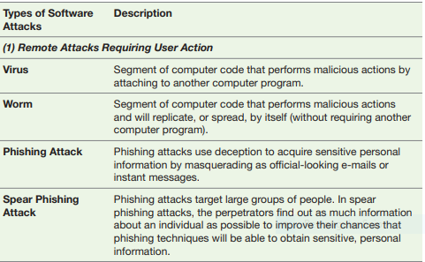

Slide 29
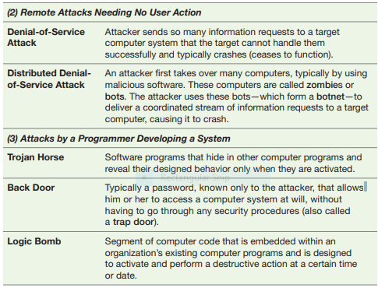

Slide 30
Software Attacks: Three Categories
Remote Attacks Requiring User Action
Virus
Worm
Phishing Attack
Spear Phishing
Notes:
(1) Remote Attacks Requiring User Action
Virus: Segment of computer code that performs malicious actions by attaching to another computer program.
Worm: Segment of computer code that performs malicious actions and will replicate, or spread, by itself (without requiring another computer program).
Phishing Attack: Phishing attacks use deception to acquire sensitive personal information by masquerading as official-looking e-mails or instant messages.
Spear Phishing: Phishing attacks target large groups of people. In spear phishing attacks, attack the perpetrators find out as much information about an individual as possible to improve their chances that phishing techniques will obtain sensitive, personal information

Slide 31
Software Attacks: Three Categories (continued)
Remote Attacks Needing No User Action
Denial-of-Service Attack
Distributed Denial-of-Service Attack
Notes:
(2) Remote Attacks Needing No User Action
Denial-of-Service Attack: An attacker sends so many information requests to a target computer system that the target cannot handle them successfully and typically crashes (ceases to function).
Distributed Denial-of-Service Attack: An attacker first takes over many computers, typically by using malicious soft ware. These computers are called zombies or bots. The attacker uses these bots—which form a botnet—to deliver a coordinated stream of information requests to a target computer, causing it to crash.

Slide 32
Software Attacks: Three Categories (continued)
Attacks by a Programmer Developing a System
Trojan Horse
Back Door
Logic bomb
Notes:
(3) Attacks by a Programmer Developing a System
Trojan Horse: Software programs that hide in other computer programs and reveal their designed behavior only when they are activated.
Back Door: Typically a password, known only to the attacker, that allows him or her to access a computer system at will, without having to go through any security procedures (also called a trap door).
Logic bomb: A segment of computer code that is embedded within an organization’s existing computer programs and is designed to activate and perform a destructive action at a certain time or date.

Slide 33
Alien Software
Alien software is clandestine software that is installed on your computer through duplicitous methods.
It typically is not as malicious as viruses, worms, or Trojan horses, but it does use up valuable system resources.
In addition, it can report on your Websurfing habits and other personal behavior

Slide 34
Alien Software
Adware: software that causes pop-up advertisements to appear on your screen.
Spyware :Spyware is software that collects personal information about users without their consent.
Two common types of spyware are keystroke loggers and screen scrapers
Keystroke loggers, also called keyloggers, record both your individual keystrokes and your Internet Web browsing history. The purposes range from criminal—for example, theft of passwords and sensitive personal information such as credit card numbers—to annoying—for example, recording your Internet search history for targeted advertising.
screen scrapers, or screen grabbers records a continuous “movie” of a screen’s
contents rather than simply recording keystrokes
Notes:
. Alien Software: clandestine soft ware that is installed on your computer through duplicitous methods.
Adware: software that causes pop-up advertisements to appear on your screen.
Spyware: soft ware that collects personal information about users without their consent. Two common types of spyware are keystroke loggers and screen scrapers.
Spamware: pestware that uses your computer as a launch pad for spammers.
Spam: unsolicited e-mail, usually advertising for products and services
Cookies: small amounts of information that Web sites store on your computer, temporarily or more or less permanently

Slide 35
Spamware:Spamware is pestware that uses your computer as a launch pad for spammers. Spam is unsolicited e-mail, usually advertising for products and services. When your computer is infected with spamware, e-mails from spammers are sent to everyone in your e-mail address book, but they appear to come from you.
Cookies :Cookies are small amounts of information that Web sites store on your computer, temporarily or more or less permanently. In many cases, cookies are useful and innocuous. For example,some cookies are passwords and user IDs that you do not want to retype every time you access the Web site that issued the cookie. Cookies are also necessary for online shopping because merchants use them for your shopping carts

Slide 36
Tracking cookies, however, can be used to track your path through a Web site, the time you spend there, what links you click on, and other details that the company wants to record, usually for marketing purposes.
Tracking cookies can also combine this information with your name, purchases, credit card information, and other personal data to develop an intrusive profile of your spending habits.

Slide 37
Supervisory Control and Data Acquisition (SCADA) Attacks
SCADA refers to a large-scale, distributed measurement and control system. SCADA systems are used to monitor or to control chemical, physical, and transport processes such as those used in oil refineries, water and sewage treatment plants, electrical generators, and nuclear power plants. Essentially, SCADA systems provide a link between the physical world and the electronic world.
SCADA systems consist of multiple sensors, a master computer, and communications infra-structure. The sensors connect to physical equipment. They read status data such as the open/ closed status of a switch or a valve, as well as measurements such as pressure, flow, voltage, and current. They control the equipment by sending signals to it, such as opening or closing a switch or a valve or setting the speed of a pump.
The sensors are connected in a network, and each sensor typically has an Internet address(Internet Protocol, or IP, address, discussed in Chapter 6). If attackers gain access to the net-work, they can cause serious damage, such as disrupting the power grid over a large area or upsetting the operations of a large chemical or nuclear plant.

Slide 38
Cyberterrorism and Cyberwarfare
Cyberterrorism and cyberwarfare refer to malicious acts in which attackers use a target’s computer systems, particularly via the Internet, to cause physical, real-world harm or severe disruption, usually to carry out a political agenda.
These actions range from gathering data to attacking critical infrastructure (e.g., via SCADA systems).

Slide 39
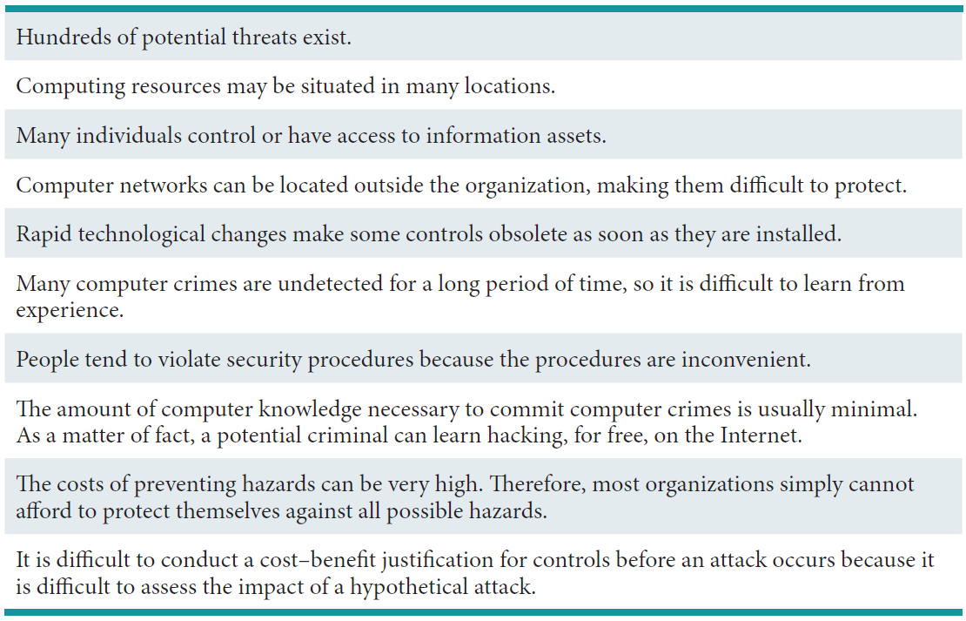
Table 7.3: The Difficulties in Protecting Information Resources

Slide 40
7.4
What Organizations Are Doing to Protect Information Resources
Risk
Risk Management
Risk Analysis
Risk Mitigation
Notes:
Risk: the probability that a threat will impact an information resource.
Risk Management: identifies, controls, and minimizes the impact of threats. In other words, risk management seeks to reduce risk to acceptable levels.
Risk Analyses: ensures IS security programs are cost effective.
Risk Mitigation: the organization takes concrete actions against risks which has two functions:
implementing controls to prevent identified threats from occurring
developing a means of recovery if the threat becomes a reality

Slide 41
Risk Management
A risk is the probability that a threat will impact an information resource.
The goal of risk management is to identify, control, and minimize the impact of threats.
In other words, risk management seeks to reduce risk to acceptable levels.
Three Processes of Risk Management:
risk analysis
risk mitigation
controls evaluation
Notes:
Risk Management: identifies, controls, and minimizes the impact of threats. In other words, risk management seeks to reduce risk to acceptable levels.
Three Processes of Risk management:
risk analysis
risk mitigation
controls evaluation
Risk Analyses: ensures IS security programs are cost effective.
Three Steps of Risk Analysis:
assessing the value of each asset being protected
estimating the probability that each asset will be compromised
comparing the probable costs of the asset’s being compromised with the costs of protecting that asset
In risk mitigation, the organization takes concrete actions against risks. Risk mitigation
has two functions: (1) implementing controls to prevent identifi ed threats from occurring,
and (2) developing a means of recovery if the threat becomes a reality. Th ere are several
risk mitigation strategies that organizations can adopt. Th e three most common are risk
acceptance, risk limitation, and risk transference.

Slide 42
Risk Analysis
Organizations perform risk analyses to ensure that their IS security programs are cost effective.
Three Steps of Risk Analysis
assessing the value of each asset being protected
estimating the probability that each asset will be compromised
comparing the probable costs of the asset’s being compromised with the costs of protecting that asset
Notes:
Risk Analyses: ensures IS security programs are cost effective.
Three Steps of Risk Analysis:
assessing the value of each asset being protected
estimating the probability that each asset will be compromised
comparing the probable costs of the asset’s being compromised with the costs of protecting that asset

Slide 43
Risk Mitigation
In risk mitigation, the organization takes concrete actions against risks
Risk mitigation has two functions: (1) implementing controls to prevent identified threats from occurring, and
(2) developing a means of recovery if the threat becomes a reality.
There are several risk mitigation strategies that organizations can adopt
Risk Acceptance : Accept the potential risk, continue operating with no controls, and absorb any damages that occur
Rick Limitation : Limit the risk by implementing controls that minimize the impact of the threat.
Risk Transference : Transfer the risk by using other means to compensate for the loss, such as by purchasing insurance
Notes:
Risk Mitigation: the organization takes concrete actions against risks which has two functions:
implementing controls to prevent identified threats from occurring
developing a means of recovery if the threat becomes a reality
----------------------
Risk acceptance: Accept the potential risk, continue operating with no controls, and absorb any damages that occur.
Risk limitation: Limit the risk by implementing controls that minimize the impact of the threat.
Risk transference: Transfer the risk by using other means to compensate for the loss, such as by purchasing insurance.

Slide 44
Information Security Controls
To protect their information assets, organizations implement controls, or defense mechanisms
These controls are designed to protect all of the components of an information system, including data, software, hardware, and networks.
Controls are intended to prevent accidental hazards, deter intentional acts, detect problems as early as possible, enhance damage recovery, and correct problems.

Slide 45
7.5
Information Security Controls
Physical Controls
Access Controls
Communications Controls
Business Continuity Planning
Information Systems Auditing
Notes:
Physical Controls: prevent unauthorized individuals from gaining access to a company’s facilities. Common physical controls include walls, doors, fencing, gates, locks, badges, guards, and alarm systems.
Access Controls: restrict unauthorized individuals from using information resources and involve two major functions: authentication and authorization.
Communication Controls (also called network controls): secure the movement of data across networks and consist of firewalls, anti-malware systems, whitelisting and blacklisting, encryption, virtual private networks (VPNs), secure socket layer (SSL), and employee monitoring systems.

Slide 46
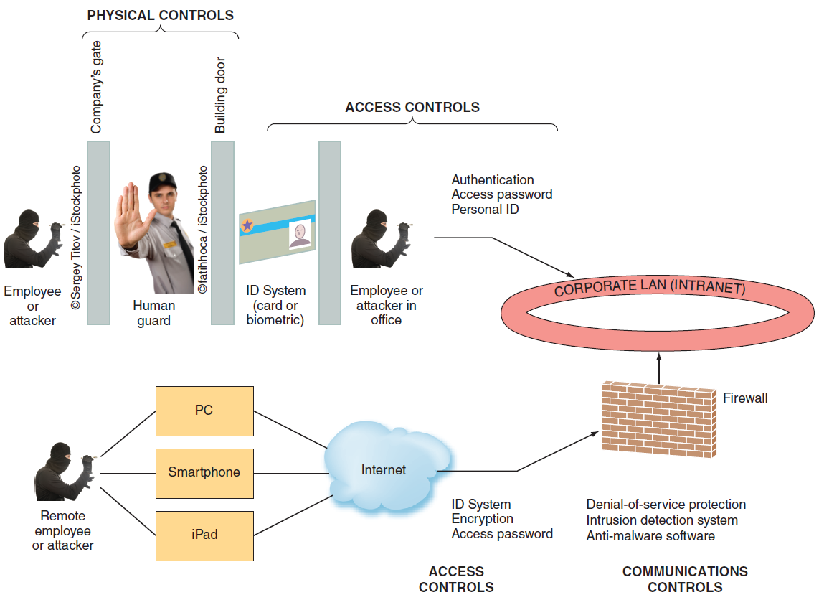
Figure 7.2: Where Defense Mechanisms are Located.

Slide 47
Physical Controls
Physical controls prevent unauthorized individuals from gaining access to a company’s facilities.
Walls
Doors
Fencing
Gates
Locks
Badges
Guards
Alarm Systems
Notes:
Physical Controls: prevent unauthorized individuals from gaining access to a company’s facilities. Common physical controls include walls, doors, fencing, gates, locks, badges, guards, and alarm systems.

Slide 48
Access Controls
Access controls restrict unauthorized individuals from using information resources.
These controls involve two major functions: authentication and authorization.
Authentication confirms the identity of the person requiring access.
After the person is authenticated (identified), Authentication the next step is authorization. Authorization determines which actions, rights, or privileges the person has, based on his or her verifi ed identity.
Authorization
Something the user is
Something the user has
Something the user does
Something the user knows
Notes:
Access Controls: restrict unauthorized individuals from using information resources and involve two major functions: authentication and authorization.
Authentication: confirms the identity of the person requiring access.
Authorization: determines which actions, rights, or privileges the person has, based on his or her verifi ed identity.
Authentication:
Something the user is: also known as biometrics, is an authentication method that examines a person’s innate physical characteristics (e.g., fingerprint scans, palm scans, retina scans, iris recognition, and facial recognition).
Something the user has: is an authentication mechanism that includes regular identifi cation (ID) cards, smart ID cards, and tokens.
Something the user does: is an authentication mechanism that includes voice and signature recognition.
Something the user knows: is an authentication mechanism that includes passwords and passphrases.

Slide 49
Communications Controls
Firewall
Anti-malware Systems
Whitelisting
Blacklisting
Encryption
Virtual Private Network (VPN)
secure socket layer (SSL)
employee monitoring systems
Notes:
Communication Controls (also called network controls): secure the movement of data across networks and consist of firewalls, anti-malware systems, whitelisting and blacklisting, encryption, virtual private networks (VPNs), secure socket layer (SSL), and employee monitoring systems.
Firewall: a system that prevents a specific type of information from moving between untrusted networks, such as the Internet, and private networks, such as your company’s network.
Anti-malware Systems (or antivirus software): software packages that attempt to identify and eliminate viruses and worms, and other malicious software.
Whitelisting: a process in which a company identifies the soft ware that it will allow to run on its computers and permits acceptable soft ware to run, and it either prevents any other soft ware from running or lets new soft ware run only in a quarantined environment until the company can verify its validity.
Blacklist: includes certain types of software that are not allowed to run in the company environment.
Encryption: the process of converting an original message into a form that cannot be read by anyone except the intended receiver.
Virtual Private Network: a private network that uses a public network (usually the Internet) to connect users. VPNs essentially integrate the global connectivity of the Internet with the security of a private network and thereby extend the reach of the organization’s networks. VPNs are called virtual because they have no separate physical existence.

Slide 50
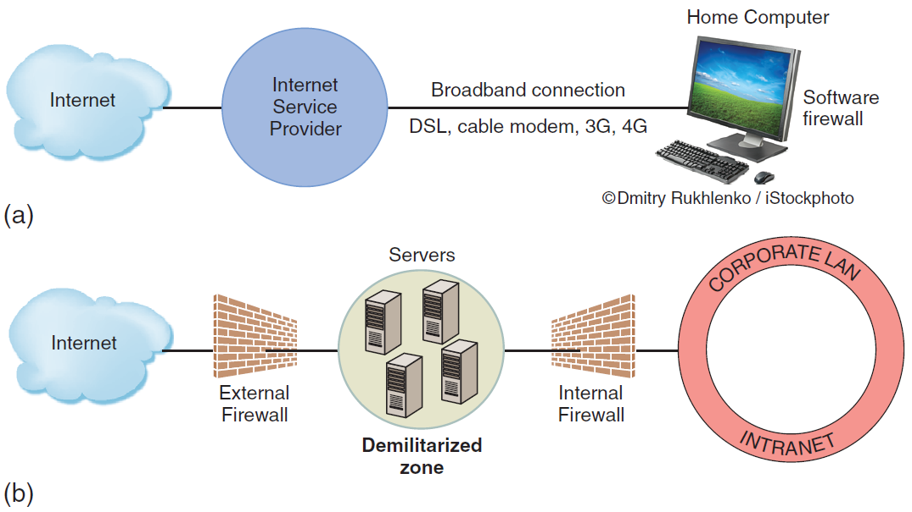
Figure 7.3: (a) Basic Firewall for Home Computer. (b) Organization with Two Firewalls and Demilitarized Zone
Notes:
Firewall: a system that prevents a specific type of information from moving between untrusted networks, such as the Internet, and private networks, such as your company’s network.
Demilitarized Zone (DMZ): located between the two firewalls. Messages from the Internet must first pass through the external firewall. If they conform to the defined security rules, they are then sent to company servers located in the DMZ.

Slide 51
Anti-malware Systems.
Anti-malware systems, also called antivirus, or AV, software, are software packages that attempt to identify and eliminate viruses and worms, and other malicious software.
AV software is implemented at the organizational level by the information systems department.
There are currently hundreds of AV software packages available.
Among the best known are Norton AntiVirus (www.symantec.com), McAfee VirusScan (www.mcafee.com), and Trend Micro PC-cillin
anti-malware systems filter traffic according to a database of specific problems.
These systems create definitions, or signatures, of various types
of malware and then update these signatures in their products.
The anti-malware software then examines suspicious computer code to determine whether it matches a known signature.
If the software identifi es a match, it removes the code. For this reason organizations regularly update their malware definitions

Slide 52
Whitelisting and Blacklisting
Whitelisting is a process in which a company identifies the software that it will allow to run on its computers.
Whitelisting permits acceptable software to run, and it either prevents any other software from running or it lets new software run in a quarantined environment until the company can verify its validity.
blacklisting allows everything to run unless it is on the blacklist.
A blacklist, then, includes certain types of software that are not allowed to run in the company environment.
For example, a company might blacklist peer-to-peer file sharing on its systems.
In addition to software, people, devices, and Web sites can also be whitelisted and blacklisted

Slide 53
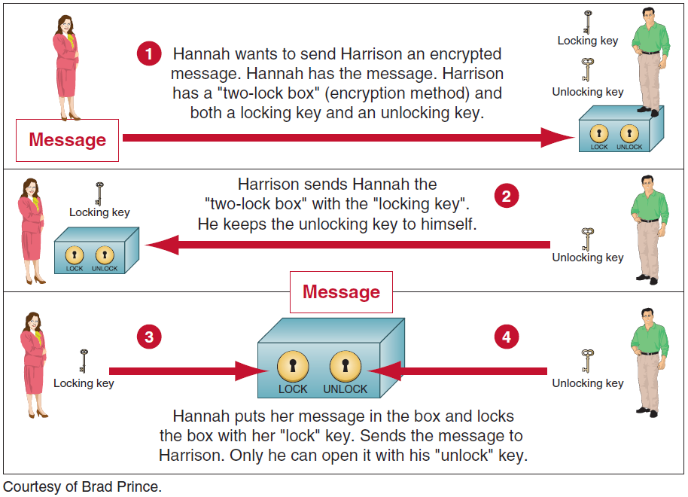
Encryption: How Public-key Encryption Works
Notes:
Encryption: the process of converting an original message into a form that cannot be read by anyone except the intended receiver.
Virtual Private Network: a private network that uses a public network (usually the Internet) to connect users. VPNs essentially integrate the global connectivity of the Internet with the security of a private network and thereby extend the reach of the organization’s networks. VPNs are called virtual because they have no separate physical existence.

Slide 54
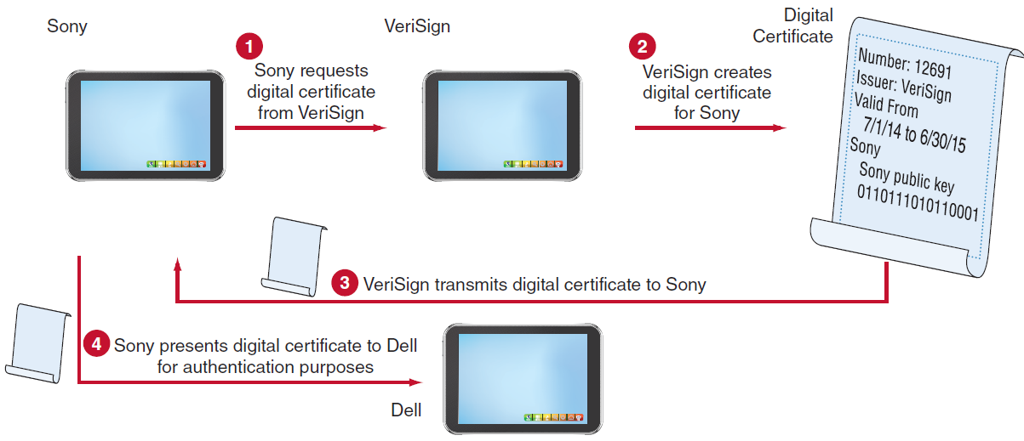
Figure 7.5: How Digital Certificates Work.

Slide 55
Virtual Private Network (VPN)
A virtual private network is a private network that uses a public network (usually the Internet) to connect users.
VPNs essentially integrate the global connectivity of the Internet with the security of a private network and thereby extend the reach of the organization’s networks.
VPNs are called virtual because they have no separate physical existence. They use the public Internet as their infrastructure.
They are created by using log-ins, encryption, and other techniques to enhance the user’s privacy, the right to be left alone and to be free of unreasonable personal intrusion

Slide 56
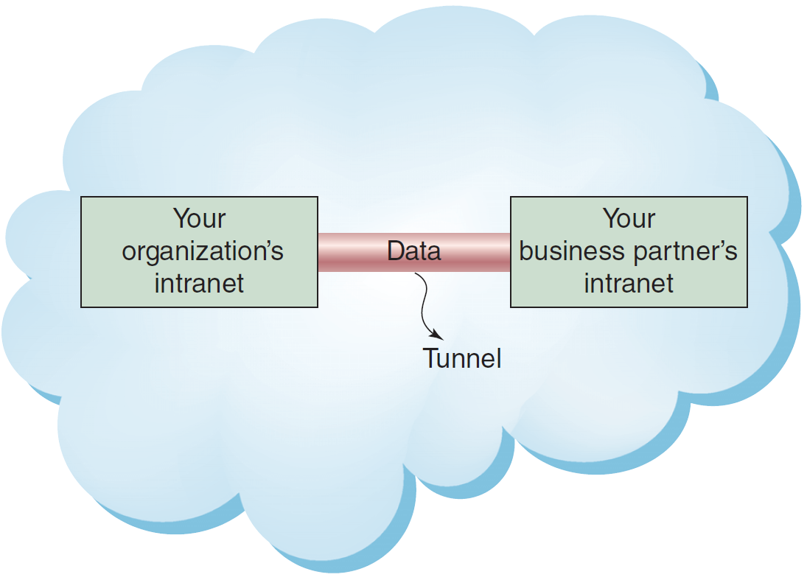
Figure 7.6: Virtual Private Network (VPN) and Tunneling

Slide 57
’S ABOUT BUSINESS 7.3
A Tale of Two Cybersecurity Firms
Describe why it was so important for law enforcement officials to capture all 96 Rustock command servers at one time.
If the perpetrators of Rustock are ever caught, will it be possible to prove that they were responsible for the malware? Why or why not? Support your answer.
Mandiant has stated that it has no definitive proof that Chinese hackers are behind the numerous attacks on U.S. companies and government agencies. Is such proof even possible to obtain? Why or why not? Support your answer. If such proof were possible to obtain, would it matter? Why or why not? Support your answer.
Discuss the advantages for FireEye of purchasing Mandiant. Then, discuss the benefits that Mandiant obtained from the sale.

Slide 58
Business Continuity Planning
In the event of a major disaster, organizations can employ several strategies for business continuity.
These strategies include hot sites, warm sites, and cold sites. A hot site is a fully configured computer facility, with all services, communications links, and physical plant operations. A hot site duplicates computing resources, peripherals, telephone systems, applications, and workstations.
Notes:
Business Continuity: the chain of events linking planning to protection and to recovery.
Business Continuity Plan: purpose is to provide guidance to people who keep the business operating aft er a disaster occurs.

Slide 59
A warm site provides many of the same services and options as thehot site. However, it typically does not include the actual applications the company needs.
A warm site includes computing equipment such as servers, but it often does not include user workstations.
A cold site provides only rudimentary services and facilities, such as a building
or a room with heating, air conditioning, and humidity control. This type of site provides no computer hardware or user workstations.
The point of a cold site is that it takes care of long lead-time issues. Building, or even renting, space takes a long time. Installing high-speed communication lines, often from two or more carriers, takes a long time. Installing high-capacity power lines takes a long time.
By comparison, buying and installing servers should not take a particularly long time.
Hot sites reduce risk to the greatest extent, but they are the most expensive option. Conversely, cold sites reduce risk the least, but they are the least expensive option.

Slide 60
Information Systems Auditing
IS environment, an audit is an examination of information systems, their inputs, outputs, and processing.
It focuses on issues such as operations, data integrity, software applications, security and privacy,budgets and expenditures, cost control, and productivity.
Guidelines are available to assist auditors in their jobs, such as those from the Information Systems Audit and Control Association
Internal Audits
External Audits
Three Categories of IS auditing procedures
Notes:
Audit: an examination of information systems, their inputs, outputs, and processing.
Two Types of Auditors and Audits:
Internal Audits
External Audits
IS auditing procedures fall into three categories:
Auditing Around the Computer: means verifying processing by checking for known outputs using specific inputs. This approach is most effective for systems with limited outputs.
Auditing Through the Computer: auditors check inputs, outputs, and processing. They review program logic, and they test the data contained within the system.
Auditing With the Computer: means using a combination of client data, auditor soft ware, and client and auditor hardware. This approach enables the auditor to perform tasks such as simulating payroll program logic using live data.

Slide 61
Three Categories of IS auditing procedures:
Auditing Around the Computer
Auditing Through the Computer
Auditing With the Computer
Notes:
IS auditing procedures fall into three categories:
Auditing Around the Computer: means verifying processing by checking for known outputs using specific inputs. This approach is most effective for systems with limited outputs.
Auditing Through the Computer: auditors check inputs, outputs, and processing. They review program logic, and they test the data contained within the system.
Auditing With the Computer: means using a combination of client data, auditor soft ware, and client and auditor hardware. This approach enables the auditor to perform tasks such as simulating payroll program logic using live data.

